Slide 1
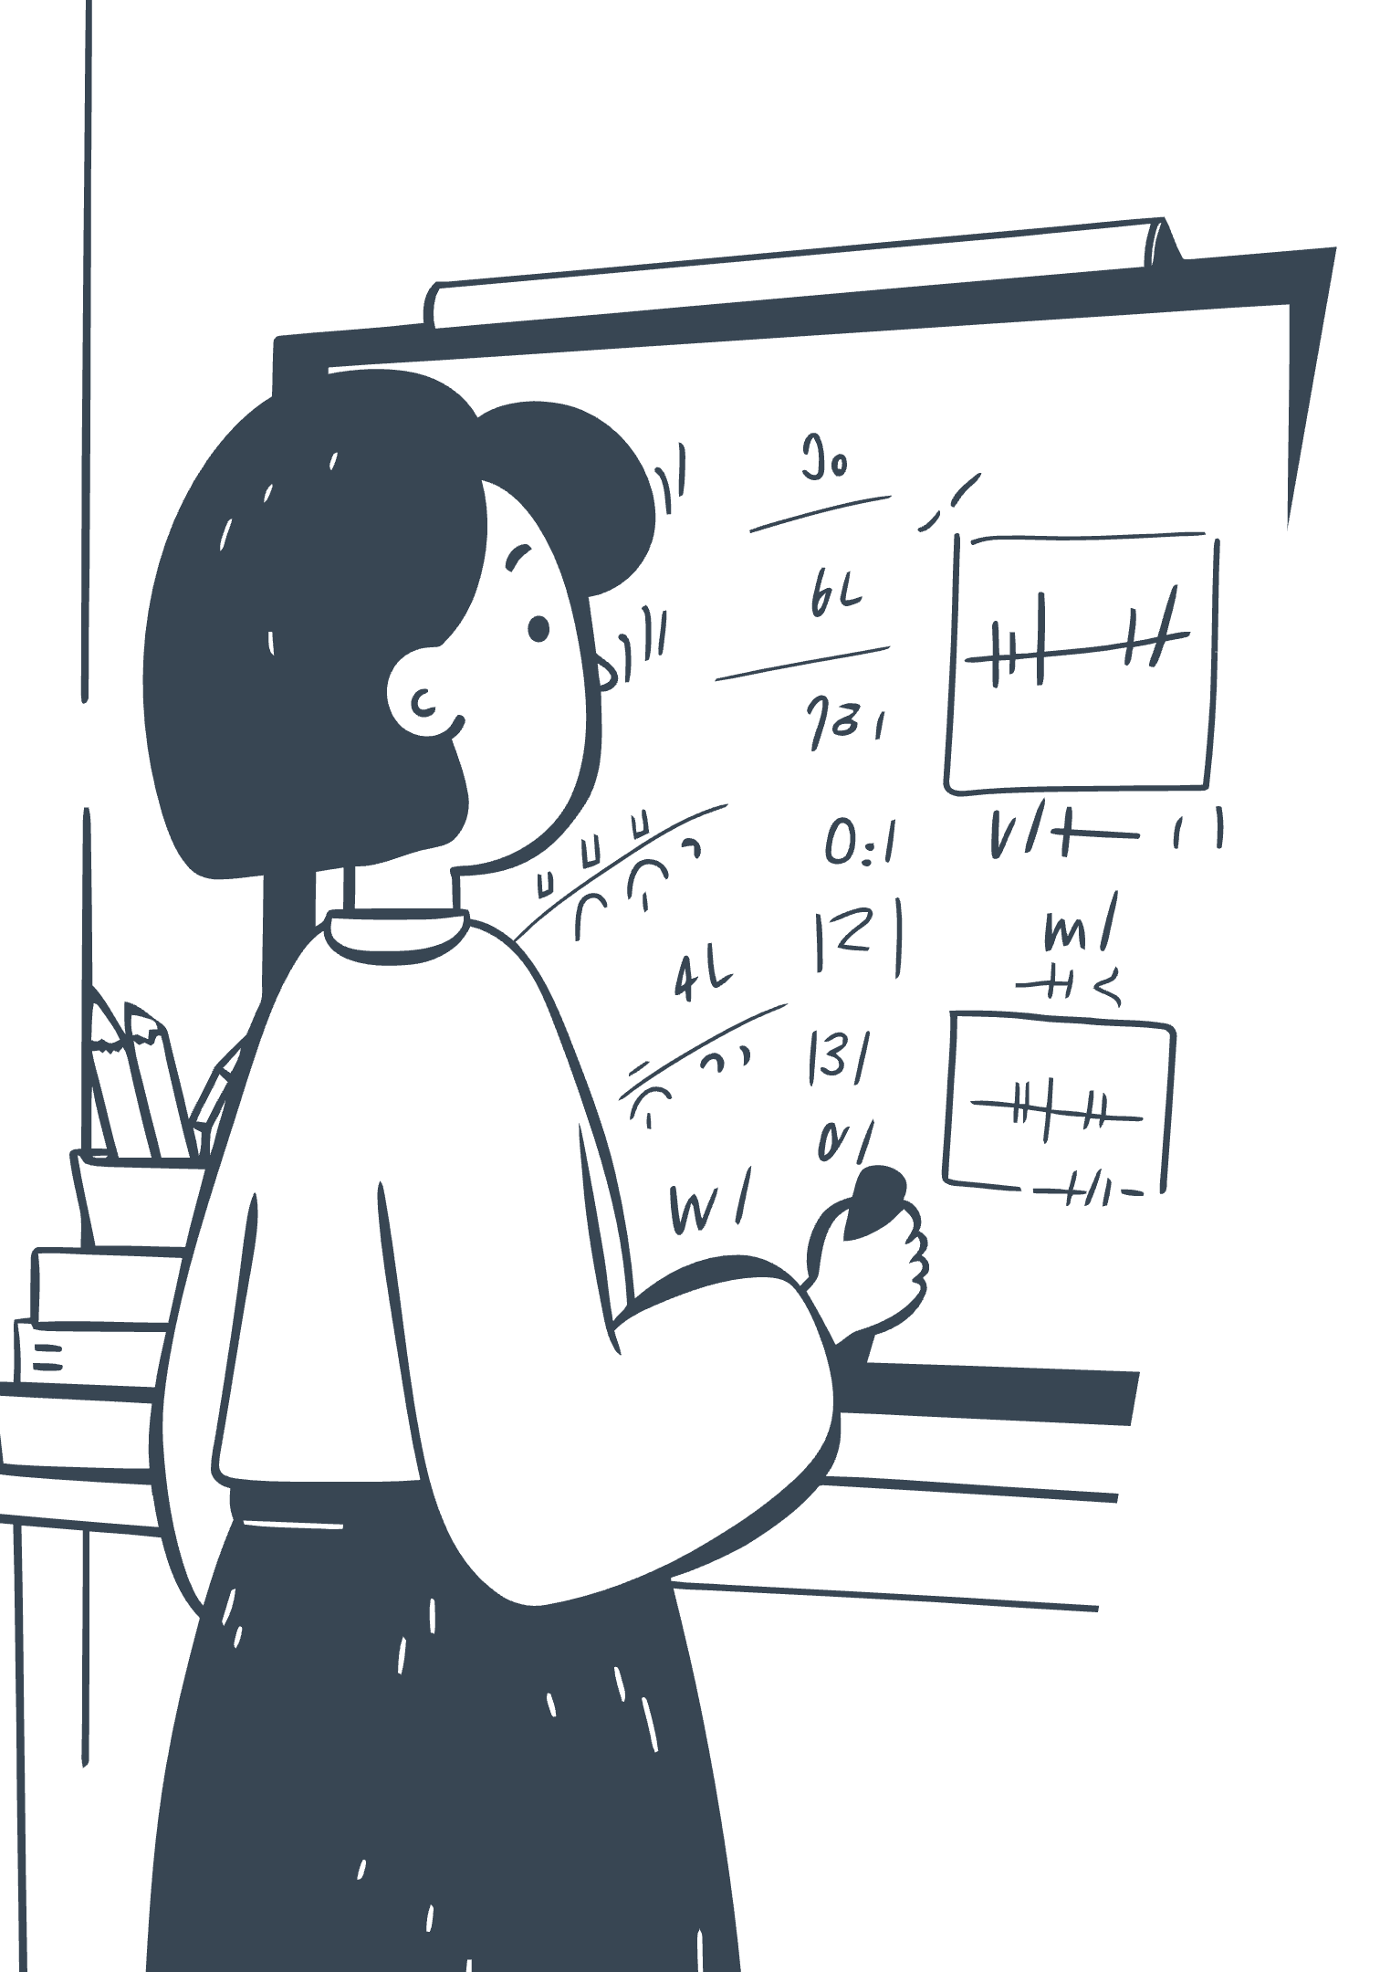
DECIMAL FRACTIONS
Primary 6 Notes
Decimal fractions are just another way of writing fractions using a dot (decimal point). This presentation covers everything you need to know about decimals, from place values to real-life applications.

Slide 2
What is a Decimal Fraction?
A decimal fraction is just another way of writing fractions using a dot (decimal point).
For example:
1/10 = 0.1
25/100 = 0.25
7/1000 = 0.007
The fraction 1/10 can be written as 0.1
The fraction 25/100 can be written as 0.25
The fraction 7/1000 can be written as 0.007
1 = numerator
10 = denominator
So decimals are fractions whose denominators are 10, 100, 1000, etc.

Slide 3

Place Value in Decimals
The value of each digit depends on its position:
Number
Place Value
25.347
2 = Tens
5 = Ones
3 = Tenths (1/10)
4 = Hundredths (1/100)
7 = Thousandths (1/1000)
💡 Tip: The first digit after the decimal point is always tenths, the next is hundredths, then thousandths.

Slide 4
Converting Fractions to Decimals
To change a fraction into a decimal:
Step 2
Step 1
Or divide the numerator by the denominator.
Make the denominator 10, 100, or 1000 (if possible).
Examples:
3/10 = 0.3
45/100 = 0.45
7/8 = 7 ÷ 8 = 0.875
The denominator is already 10
The denominator is already 100
Divide numerator by denominator

Slide 5
Converting Decimals to Fractions
0.6
=
6
10
To change decimals into fractions:
Write the decimal without the dot as the numerator.
Use 10, 100, 1000... as denominator depending on the number of decimal places.
Simplify if possible.
Examples:
1
2
3
0.6
0.25
0.125
0.6 = 6/10 = 3/5
0.25 = 25/100 = 1/4
0.125 = 125/1000 = 1/8

Slide 6
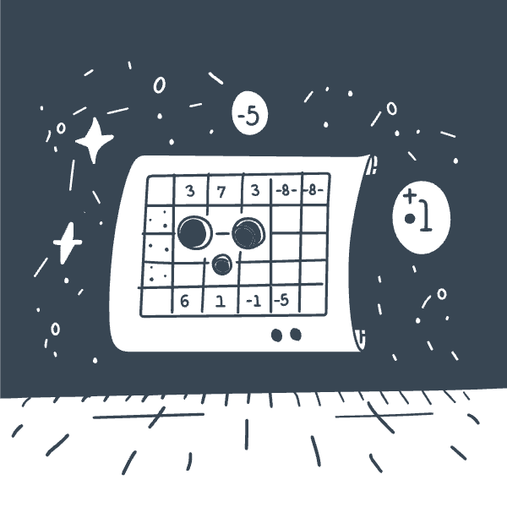



Comparing Decimals
How to compare:
Line up the decimals by the decimal point.
Compare digit by digit.
Example:
Comparing 0.45 and 0.5
0.45
0.5
Result
0.45 = 45/100
0.5 = 50/100
So 0.5 > 0.45

Slide 7
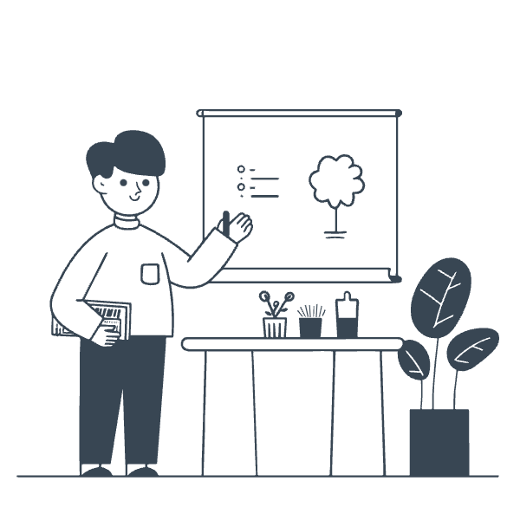




Addition & Subtraction of Decimals
How to add or subtract:
Line up decimal points.
Add or subtract as in whole numbers.
Examples:
Addition
Subtraction
2.35 + 4.2 = 6.55
7.8 – 3.45 = 4.35

Slide 8
Multiplication of Decimals
Step 3
Step 2
Place the decimal in the answer.
Step 1
Count total decimal places in both numbers.
Multiply normally (ignore decimal points).
Example:
2.3 × 1.2
Multiply: 23 × 12 = 276
Total decimal places = 2
Answer = 2.76

Slide 9




Division of Decimals
How to divide:
If divisor is a decimal, make it a whole number by moving the decimal point.
Divide as usual.
Example:
Problem
Step 1
Step 2
6.4 ÷ 0.2
Change 0.2 to 2 → Move decimal once.
64 ÷ 2 = 32

Slide 10
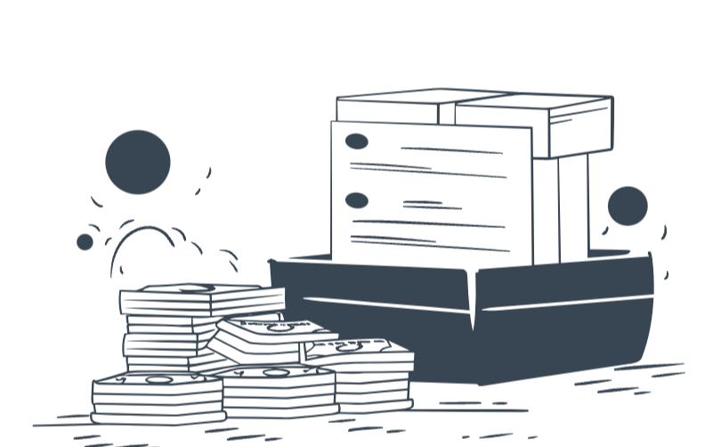
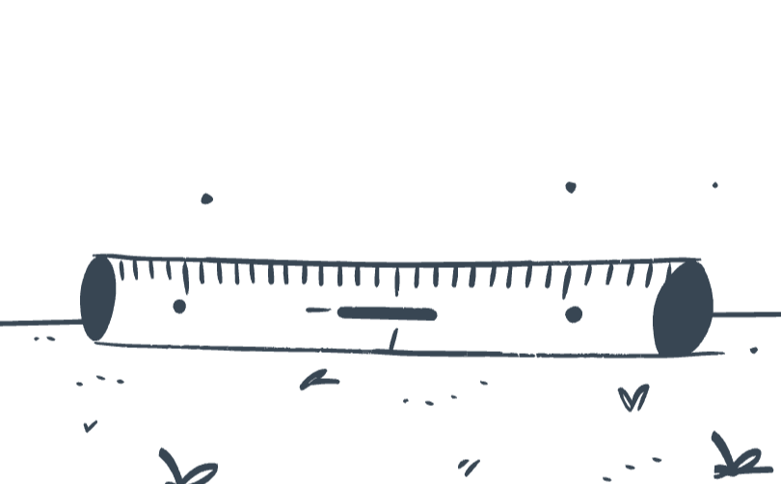
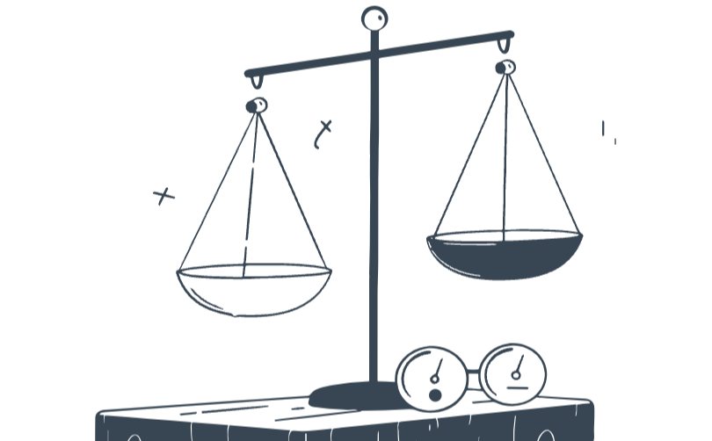

Real-Life Uses of Decimals
Money
Measurement
Weight
Time
₵3.50 = 3 cedis and 50 pesewas
2.75m = 2 meters and 75 cm
1.25kg = 1 kg and 250 g
1.5 hours = 1 hour 30 minutes
✅ Quick Exercise for Students
Write these as decimals: a) 7/10 b) 35/100 c) 9/1000
Write as fractions in simplest form: a) 0.8 b) 0.45 c) 0.125
Add: 4.25 + 3.7
Multiply: 0.6 × 0.4
Divide: 7.5 ÷ 0.5

Slide 11
Steps.
When are the decimal places of the numbers the same?
1. Convert to a normal number
2. Then divide
3. The answer you get, becomes your final answer.
However, when they are not the same, use
1. Make the divisor a whole number.
• If the divisor (the number you’re dividing by) has decimal places, multiply both numbers by 10, 100, etc. until the divisor becomes a whole number.
2. Divide normally (like whole numbers).
3. Place the decimal point in the quotient (answer).
• The position depends on how many times you moved the decimal point earlier.

Slide 12
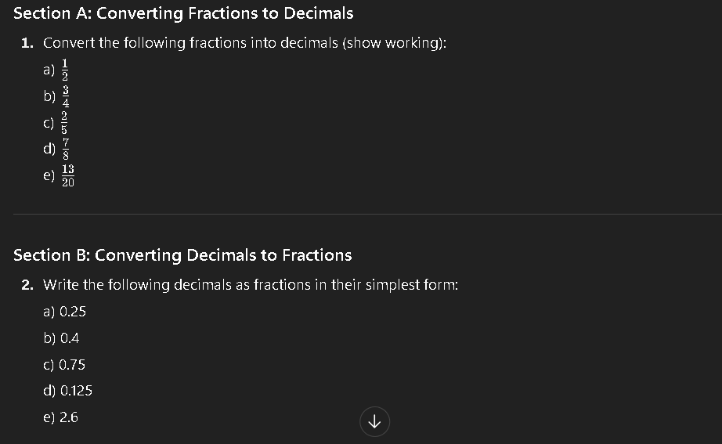
HOMEWORK

Slide 13
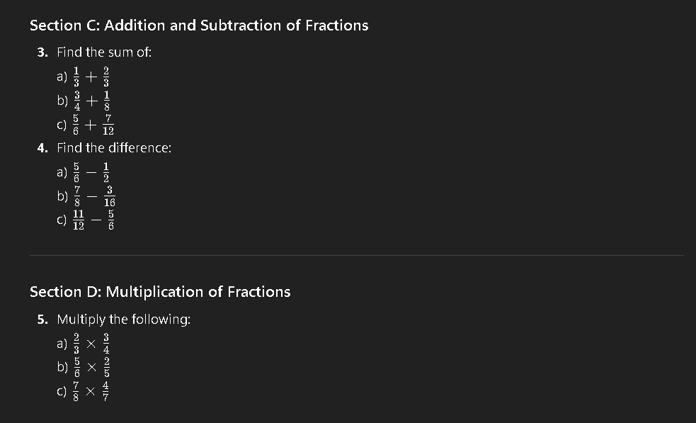

Slide 14
